Slide 1
PowerPoint Presentation FOR
FLIPKART
PRESENTED BY Tridev Pal
Notes:
Tridev pal

Slide 2
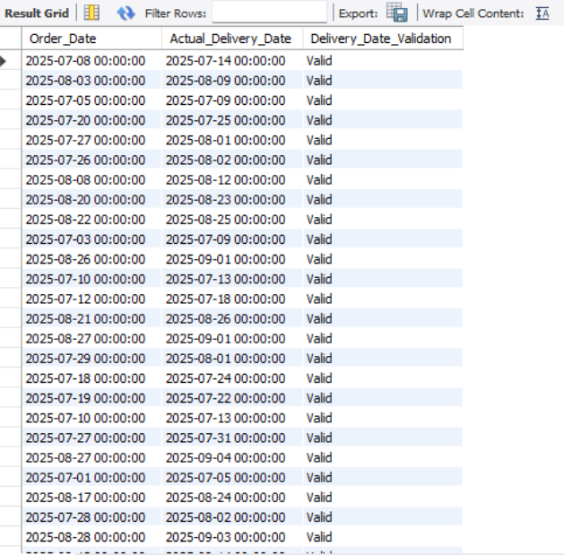
Data Cleaning & Preparation
IDENTIFY AND DELETE DUPLICATE ORDER_ID RECORDS.
I Identified and delete duplicate Order_ID records in SQL.
REPLACE NULL TRAFFIC_DELAY_MIN WITH THE AVERAGE DELAY FOR THAT ROUTE.
To replace NULL values in Traffic_Delay_Min with the average delay of the same route, we can use an
UPDATE statement with a subquery that calculates the average per Route_ID.
CONVERT ALL DATE COLUMNS INTO YYYY-MM-DD FORMAT USING SQL FUNCTIONS.
I convert all date columns into YYYY-MM-DD format in SQL for SHIPMENT AND ORDERS using
{ UPDATE shipment
SET Checkpoint_Time = STR_TO_DATE(Checkpoint_Time, '%d-%m-%Y %H.%i')
WHERE STR_TO_DATE(Checkpoint_Time, '%d-%m-%Y %H.%i') IS NOT NULL;
ALTER TABLE shipment
MODIFY Checkpoint_Time DATETIME;}
ENSURE THAT NO ACTUAL_DELIVERY_DATE IS BEFORE ORDER_DATE (FLAG SUCH RECORDS).
i have ensure that no actual delivery date is before order date and i have used flags "valid" &"invalid"
SELECT
Order_Date,
Actual_Delivery_Date,
CASE
WHEN Actual_Delivery_Date < Order_Date THEN 'Invalid'
ELSE 'Valid'
END AS Delivery_Date_Validation
FROM orders;
ALTER TABLE orders
ADD COLUMN Delivery_Date_Validation VARCHAR(10)
GENERATED ALWAYS AS (
CASE
WHEN Actual_Delivery_Date < Order_Date THEN 'Invalid'
ELSE 'Valid'
END
);

Slide 3
Delivery Delay Analysis
Calculate delivery delay (in days) for each order
I figured out the delivery delay by simply looking at when orders were actually delivered compared to when they were supposed to arrive. If something showed up on time, I marked it as “0” days delay. For the ones that came late, I just counted how many extra days it took. From what I found , most orders actually made it on time, which is pretty good. There were a few stragglers that took an extra 1 to 3 days, but overall, the delivery performance looks solid.
Find Top 10 delayed routes based on average delay days.
Our logistics team needs to step up their game - routes RT_13, RT_09, and RT_14 are experiencing unacceptable delays of over half a day to over a day, impacting customer satisfaction and reputation.
Use window functions to rank all orders by delay within each warehouse
I have use window function to rank warehouses
I ranked orders by delay within each warehouse, with rank 1 being the most delayed. This helps me focus on the orders that need the most attention, and I can compare warehouse performance based on timely deliveries
Order_ID,
Warehouse_ID,
DATEDIFF(Actual_Delivery_Date, Expected_Delivery_Date) AS Delay_Days,
DENSE_RANK() OVER (PARTITION BY Warehouse_ID ORDER BY DATEDIFF(Actual_Delivery_Date, Expected_Delivery_Date)desc ) AS Delay_Rank
FROM orders
WHERE Actual_Delivery_Date IS NOT NULL;

Slide 4
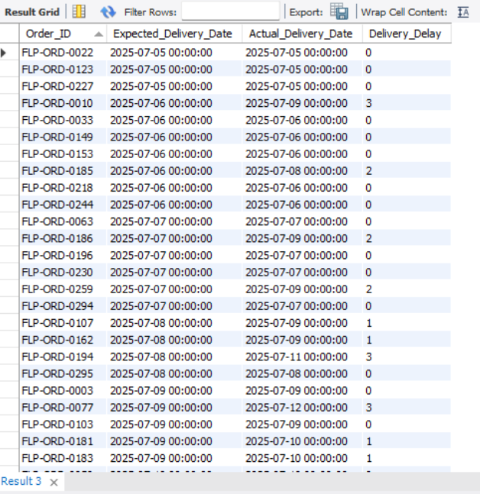
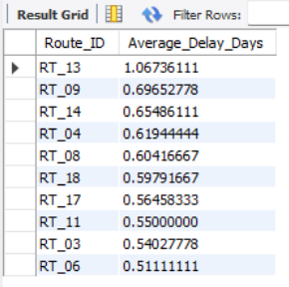
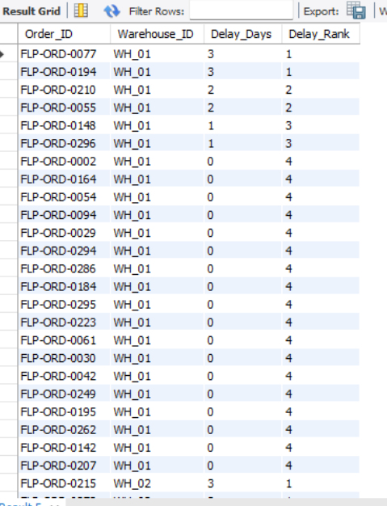
Calculate delivery delay (in days) for each order
Find Top 10 delayed routes based on average delay days.
Use window functions to rank all orders by delay within each warehouse
SELECT Order_ID, Expected_Delivery_Date, Actual_Delivery_Date, DATEDIFF(Actual_Delivery_Date, Expected_Delivery_Date) AS Delivery_DelayFROM orders;
SELECT Route_ID, (AVG(Average_Travel_Time_Min + Traffic_Delay_Min) / 1440.0) AS Average_Delay_DaysFROM routesGROUP BY Route_IDORDER BY Average_Delay_Days DESCLIMIT 10;
SELECT Order_ID, Warehouse_ID, DATEDIFF(Actual_Delivery_Date, Expected_Delivery_Date) AS Delay_Days, DENSE_RANK() OVER (PARTITION BY Warehouse_ID ORDER BY DATEDIFF(Actual_Delivery_Date, Expected_Delivery_Date)desc ) AS Delay_RankFROM orders WHERE Actual_Delivery_Date IS NOT NULL;

Slide 5
Route Optimization Insights
AVERAGE DELIVERY TIME (IN DAYS)
On average, deliveries across all routes are completed in less than a day, which shows that the process is running smoothly.
A few routes, like RT_13, take a bit longer more than a day , while others — especially RT_02, RT_19, and RT_10 — are consistently faster. Seeing this difference helps highlight which routes are performing well and which ones may need a closer look . Overall, delivery times are quick and efficient.
AVERAGE TRAFFIC DELAY
The average traffic delay is Average 46.85 min
DISTANCE-TO-TIME EFFICIENCY RATIO: DISTANCE_KM / AVERAGE_TRAVEL_TIME_MIN.
Routes like RT_19 , RT_12, and RT_10 are performing really well, covering more distance without taking extra time.
On the other hand, routes such as RT_14 and RT_13 seem less efficient and may need a review or better planning.
IDENTIFY 3 ROUTES WITH THE WORST EFFICIENCY RATIO.
We've got some routes that need attention - RT_19 is covering a lot of ground and RT_12 is taking a long time.
RT_19's route rating is also the worst, so let's take a closer look and see if we can make some improvements.
FIND ROUTES WITH >20% DELAYED SHIPMENTS.
Our shipping operations are facing significant challenges, with multiple routes experiencing delay percentages over 300%.
RT_11, RT_05, RT_18, and RT_08 are among the worst performers, with delay rates ranging from 393% to 433%.
We need to optimize these routes to reduce delays and improve overall efficiency .
RECOMMEND POTENTIAL ROUTES FOR OPTIMIZATION.
Prioritize optimizing routes RT _11, RT_05, RT_18 , and RT_ 08, which have the highest delay percentages.
By analyzing these routes, we can identify bottlenecks and implement changes to reduce delays and improve overall efficiency.

Slide 6
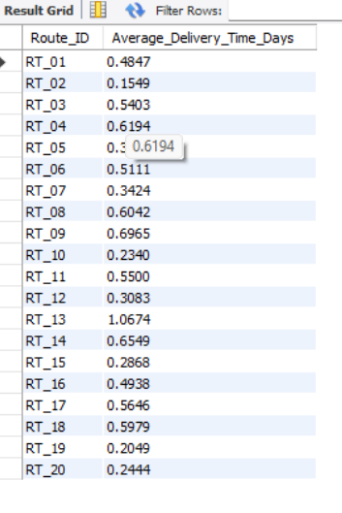
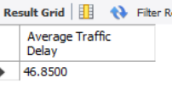
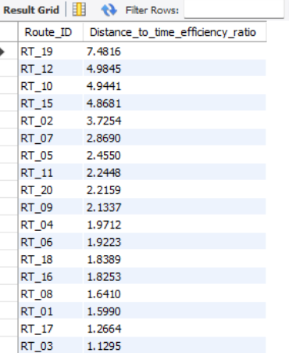
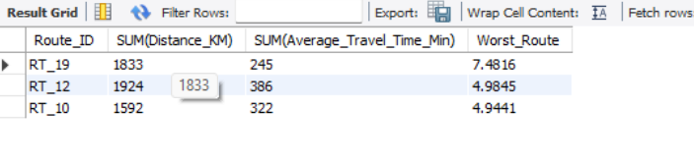
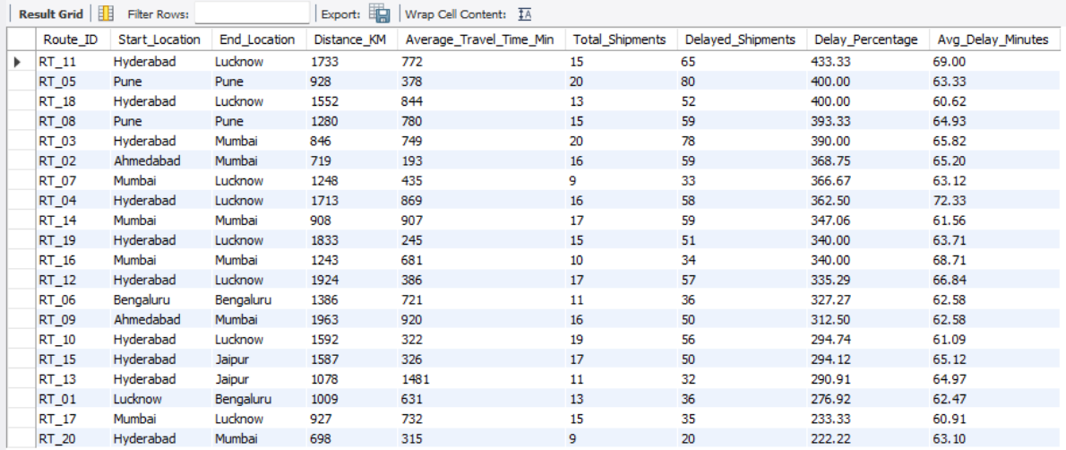
Average delivery time (in days)
Average traffic delay.
-- Distance-to-time efficiency ratio: Distance_KM / Average_Travel_Time_Min.
Identify 3 routes with the worst efficiency ratio.
Find routes with >20% delayed shipments.
Recommend potential routes for optimization.
Routes RT_19, RT_12, and RT_10 take the most time even though they cover long distances, so improving these will have the biggest impact. Also, RT_11, RT_05, and RT_18 often face delays and late deliveries, so they should be looked into as well.

Slide 7
Average delivery time (in days)
Find routes with >20% delayed shipments.
-- Distance-to-time efficiency ratio: Distance_KM / Average_Travel_Time_Min.
WITH shipment_delays AS ( -- Identify if each shipment has any delays SELECT Tracking_ID, Order_ID, MAX(CASE WHEN Delay_Minutes > 0 THEN 1 ELSE 0 END) AS is_delayed, SUM(COALESCE(Delay_Minutes, 0)) AS Total_Delay_Minutes FROM shipment GROUP BY Tracking_ID, Order_ID),route_delay_stats AS ( -- Calculate delay statistics per route SELECT r.Route_ID, r.Start_Location, r.End_Location, r.Distance_KM, r.Average_Travel_Time_Min, COUNT(DISTINCT o.Order_ID) AS Total_Shipments, SUM(sd.is_delayed) AS Delayed_Shipments, ROUND(100.0 * SUM(sd.is_delayed) / COUNT(DISTINCT o.Order_ID), 2) AS Delay_Percentage, ROUND(AVG(sd.total_delay_minutes), 2) AS Avg_Delay_Minutes FROM routes r INNER JOIN orders o ON r.Route_ID = o.Route_ID INNER JOIN shipment_delays sd ON o.Order_ID = sd.Order_ID GROUP BY r.Route_ID, r.Start_Location, r.End_Location, r.Distance_KM, r.Average_Travel_Time_Min)SELECT Route_ID, Start_Location, End_Location, Distance_KM, Average_Travel_Time_Min, Total_Shipments, Delayed_Shipments, Delay_Percentage, Avg_Delay_MinutesFROM route_delay_statsWHERE delay_percentage > 0.2ORDER BY delay_percentage DESC, total_shipments DESC;
SELECT Route_ID, (Average_Travel_Time_Min + Traffic_Delay_Min) / 1440.0 AS Average_Delivery_Time_DaysFROM routes;
select Route_ID, sum(Distance_KM)/ sum(Average_Travel_Time_Min) as Distance_to_time_efficiency_ratio from routes group by Route_ID order by Distance_to_time_efficiency_ratio desc;-- Identify 3 routes with the worst efficiency ratio.SELECT Route_ID, SUM(Distance_KM), SUM(Average_Travel_Time_Min), (SUM(Distance_KM) / SUM(Average_Travel_Time_Min)) AS Worst_RouteFROM routesGROUP BY Route_IDORDER BY Worst_Route DESCLIMIT 3;
Identify 3 routes with the worst efficiency ratio.
Average traffic delay.
SELECT Route_ID, SUM(Distance_KM), SUM(Average_Travel_Time_Min), (SUM(Distance_KM) / SUM(Average_Travel_Time_Min)) AS Worst_RouteFROM routesGROUP BY Route_IDORDER BY Worst_Route DESCLIMIT 3;
select avg(Traffic_Delay_Min) as "Average Traffic Delay" from routes;

Slide 8
Warehouse Performance
Find the top 3 warehouses with the highest average processing time.
Our top 3 warehouses with the highest average processing times are WH_10 in Chennai with 117 minutes,
WH _09 in Hyderabad with 110 minutes, and WH_01 in Lucknow with 101 minutes.
Calculate total vs. delayed shipments for each warehouse.
Some warehouses are experiencing extremely high delay percentages, especially WH_10 and WH_03,
Which show significantly more delayed shipments than total shipments. WH_09 and WH_01 are also
Struggling and may need immediate attention to improve processing speed and route planning. A few centers
Like WH_07 and WH_04 are performing slightly better, but still have room to improve. Prioritizing workflow
Fixes and addressing bottlenecks at the top delaying warehouses could greatly reduce overall delays.
Use CTEs to find bottleneck warehouses where processing time > global average.
Most of our warehouses are taking longer than the global average processing time.
Wh_ 10 and wh _09 are lagging significantly behind, with processing times 47% and 39% above average, respectively.
Rank warehouses based on on-time delivery percentage.
The Hyderabad center is doing a great job — most of its orders are delivered on time, showing solid efficiency.
Warehouses like Kolkata and Lucknow are performing decently too, but there’s still room to improve.
Mumbai and Chennai are falling behind and may need extra focus to boost their delivery speed.
The system works well, but a little fine-tuning at the slower centers could make a big difference.

Slide 9
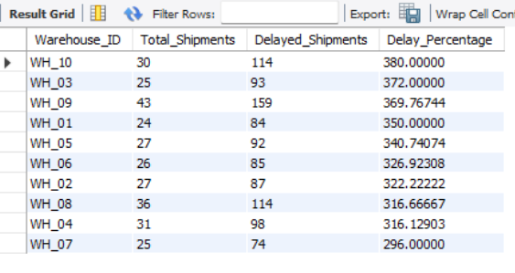
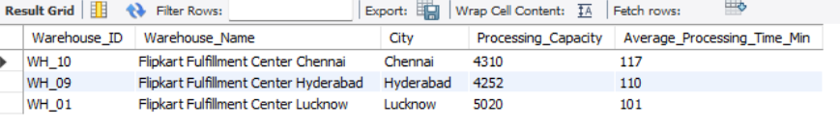
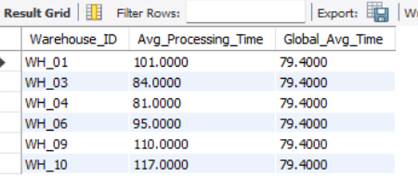
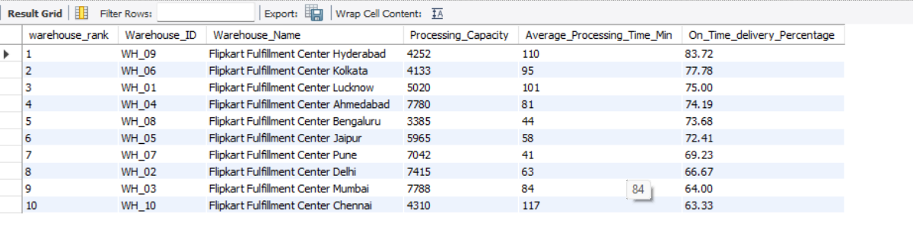
Find the top 3 warehouses with the highest average processing time.
Calculate total vs. delayed shipments for each warehouse.
Use CTEs to find bottleneck warehouses where processing time > global average.
Rank warehouses based on on-time delivery percentage.

Slide 10
Find the top 3 warehouses with the highest average processing time.
Calculate total vs. delayed shipments for each warehouse.
SELECT * FROM warehouses order by Average_Processing_Time_Min DESC limit 3;
SELECT o.Warehouse_ID, COUNT(DISTINCT o.Order_ID) AS Total_Shipments, SUM(CASE WHEN s.Delay_Minutes > 0 THEN 1 ELSE 0 END) AS Delayed_Shipments, (SUM(CASE WHEN s.Delay_Minutes > 0 THEN 1 ELSE 0 END) * 100.0 / COUNT(DISTINCT o.Order_ID)) AS Delay_PercentageFROM orders oJOIN shipment s ON o.Order_ID = s.Order_IDGROUP BY o.Warehouse_IDORDER BY Delay_Percentage DESC;
Rank warehouses based on on-time delivery percentage.
Use CTEs to find bottleneck warehouses where processing time > global average.
WITH Warehouse_Delivery_Stats AS ( SELECT w.Warehouse_ID, w.Warehouse_Name, w.City, w.Processing_Capacity, w.Average_Processing_Time_Min, COUNT(o.Order_ID) AS Total_Orders, SUM(CASE WHEN o.Actual_Delivery_Date <= o.Expected_Delivery_Date THEN 1 ELSE 0 END) AS On_Time_Deliveries, SUM(CASE WHEN o.Actual_Delivery_Date > o.Expected_Delivery_Date THEN 1 ELSE 0 END) AS delayed_Deliveries, SUM(CASE WHEN o.Actual_Delivery_Date IS NULL THEN 1 ELSE 0 END) AS Pending_Deliveries, ROUND(100.0 * SUM(CASE WHEN o.Actual_Delivery_Date <= o.Expected_Delivery_Date THEN 1 ELSE 0 END) / COUNT(o.Order_ID), 2) AS On_Time_Delivery_Percentage FROM warehouses w LEFT JOIN orders o ON w.Warehouse_ID = o.Warehouse_ID GROUP BY w.Warehouse_ID, w.Warehouse_Name, w.City, w.Processing_Capacity, w.Average_Processing_Time_Min)SELECT RANK() OVER (ORDER BY On_Time_Delivery_Percentage DESC, total_orders DESC) AS warehouse_rank, Warehouse_ID, Warehouse_Name, Processing_Capacity, Average_Processing_Time_Min, On_Time_delivery_PercentageFROM Warehouse_Delivery_StatsWHERE Total_Orders > 0 -- Only include warehouses with ordersORDER BY Warehouse_Rank;
WITH WarehouseStats AS ( -- CTE #1: Calculate avg processing time per warehouse SELECT Warehouse_ID, AVG(Average_Processing_Time_Min) AS Avg_Processing_Time FROM warehouses GROUP BY Warehouse_ID),GlobalAvg AS ( -- CTE #2: Calculate the global avg processing time SELECT AVG(Average_Processing_Time_Min) AS Global_Avg_Time FROM warehouses)-- Final Select: Compare and filter bottlenecksSELECT w.Warehouse_ID, w.Avg_Processing_Time, g.Global_Avg_TimeFROM WarehouseStats wCROSS JOIN GlobalAvg gWHERE w.Avg_Processing_Time > g.Global_Avg_Time;

Slide 11
Delivery Agent Performance
Rank agents (per route) by on-time delivery percentage
Rajesh Sharma leads the ranking , showing strong performance and consistency, followed closely by Kiran Reddy and Meena Patel. The top agents clearly stand out with their efficiency and dedication. As we move down the list, the rankings show a gradual drop , suggesting that some agents may need guidance or support to improve. The data highlights a strong core team with potential for others to catch up.
Find agents with on-time % < 80%.
Rajesh Sharma leads the ranking, showing strong performance and efficiency on his assigned route.
Agents like Kiran Reddy and Meena Patel are also performing well and maintaining consistent delivery results. As the ranks go lower, performance becomes more varied — some agents may benefit from additional training or better route support. The top agents set a great example, and with a little guidance, the rest can improve too.
Compare average speed of top 5 vs bottom 5 agents using subqueries.
The top 5 agents are clearly performing much faster, with an average speed of 53.02.
Compared to them, the bottom 5 agents average only 35.32, showing a noticeable gap in productivity.
This highlights that while a few agents are highly efficient, others may need additional guidance or training to catch up.
Improving the performance of the slower group could significantly boost overall efficiency.
Suggest training or workload balancing strategies for low performers
Some agents with low on-time deliveries might just need extra help with routes and time planning.
A short refresher on handling traffic and managing deliveries could make a big difference.
Pairing them with top performers can help them learn faster.
It may also help to share the tougher routes more evenly and give a bit more time for busy areas.
Regular check-ins and feedback will keep everyone on track and improving.

Slide 12
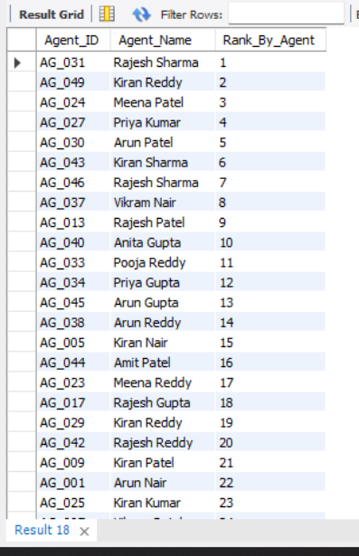
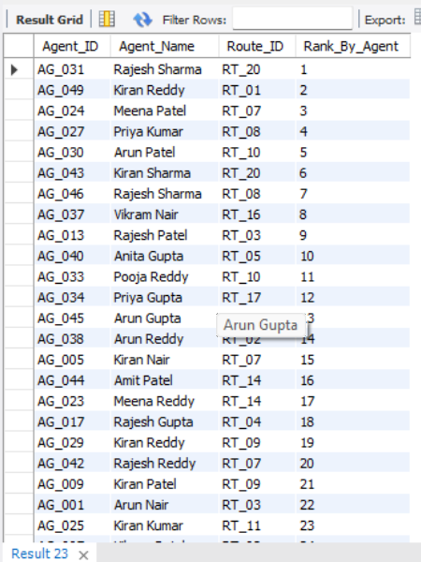
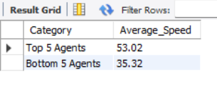
Rank agents (per route) by on-time delivery percentage
Find agents with on-time % < 80%.
Compare average speed of top 5 vs bottom 5 agents using subquerie
Suggest training or workload balancing strategies for low performers
Some agents with low on-time deliveries might just need extra help with routes and time planning.
A short refresher on handling traffic and managing deliveries could make a big difference.
Pairing them with top performers can help them learn faster.
It may also help to share the tougher routes more evenly and give a bit more time for busy areas.
Regular check-ins and feedback will keep everyone on track and improving.

Slide 13
Rank agents (per route) by on-time delivery percentage
Find agents with on-time % < 80%.
Compare average speed of top 5 vs bottom 5 agents using subquerie
select Agent_ID,Agent_Name, rank() over(order by On_Time_Delivery_Percentage desc) as Rank_By_Agent from deliveryagents;
SELECT Agent_ID, Agent_Name, Route_ID, Rank_By_AgentFROM ( SELECT Agent_ID, Agent_Name, Route_ID, PERCENT_RANK() OVER (ORDER BY On_Time_Delivery_Percentage DESC) AS Percent_Rank_By_Agent, DENSE_RANK() OVER (ORDER BY On_Time_Delivery_Percentage DESC) AS Rank_By_Agent FROM deliveryagents) AS subqueryWHERE Percent_Rank_By_Agent <= 0.8;
SELECT 'Top 5 Agents' AS Category, AVG(Avg_Speed_KMPH) AS Average_SpeedFROM (SELECT Agent_ID, Avg_Speed_KMPH FROM deliveryagents ORDER BY Avg_Speed_KMPH DESC LIMIT 5) AS top_agents UNION ALL SELECT 'Bottom 5 Agents' AS Category, round(AVG(Avg_Speed_KMPH),2) AS Average_SpeedFROM (SELECT Agent_ID, Avg_Speed_KMPH FROM deliveryagents ORDER BY Avg_Speed_KMPH ASC LIMIT 5) AS bottom_agents;

Slide 14

Shipment Tracking Analytics
For each order, list the last checkpoint and time.
It shows the final checkpoint and the exact time it was last scanned, making it easy to follow where every shipment currently stands. Overall, the data feels organized and helps quickly identify orders that may need attention or follow-up.
Find the most common delay reasons (excluding None).
Traffic is clearly the biggest cause of delays, showing up far more often than anything else. Average processing delays also show up frequently, meaning some internal steps might be slowing things down. Weather and technical issues happen less often, but they still contribute to delays. Focusing on reducing traffic-related and process delays could significantly improve overall delivery performance.
Identify orders with >2 delayed checkpoints
A large number of orders are hitting more than two delayed checkpoints, which shows consistent bottlenecks in the delivery process. Some orders even have 7–9 delays, meaning they’re getting held up multiple times along the route. These repeated delays could impact customer satisfaction and delivery promises. We have to focusing on identifying where these delays happen can help streamline the process and improve delivery speed.

Slide 15
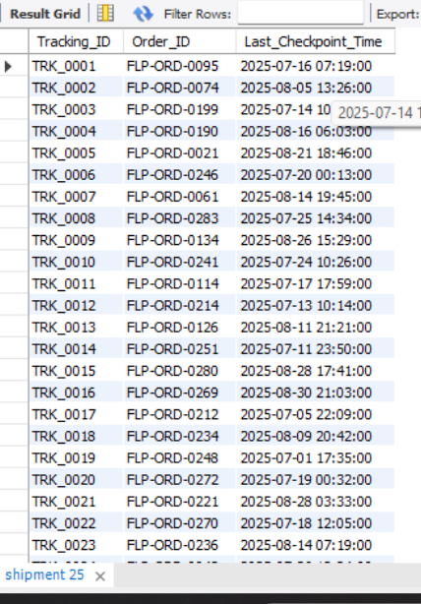
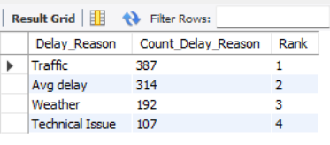
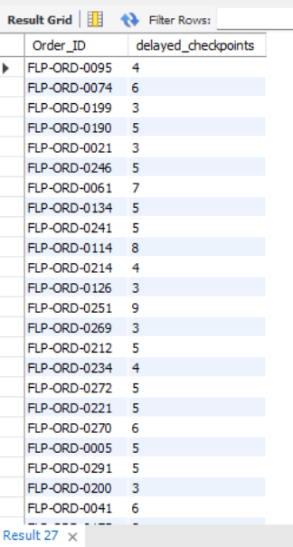
For each order, list the last checkpoint and time.
Find the most common delay reasons (excluding None).
Identify orders with >2 delayed checkpoints

Slide 16
For each order, list the last checkpoint and time.
Find the most common delay reasons (excluding None).
Identify orders with >2 delayed checkpoints
select Tracking_ID, Order_ID, Checkpoint_Time as Last_Checkpoint_Time from shipment;
SELECT Delay_Reason, COUNT(*) AS Count_Delay_Reason, RANK() OVER (ORDER BY COUNT(*) DESC) AS 'Rank'FROM shipmentGROUP BY Delay_Reason;
SELECT Order_ID, COUNT(Tracking_ID) AS delayed_checkpointsFROM shipmentWHERE Delay_Minutes > 0GROUP BY Order_IDHAVING COUNT(Tracking_ID) > 2;

Slide 17
Advanced KPI Reporting
Calculate KPIs using SQL queries:
Average Delivery Delay per Region (Start_Location).
Bengaluru and Mumbai show some of the highest average delivery delays, which suggests heavy congestion or operational slowdowns in those regions.
Hyderabad also appears to be a frequent source of delays, especially on routes like Hyderabad to Jaipur.
A few routes, like Lucknow to Bengaluru and Ahmedabad to Mumbai, perform slightly better but still have long delays.
On-Time Delivery % = (Total On-Time Deliveries / Total Deliveries) * 100.
The on-time delivery rate of around 72.7% is decent, but there’s still room to improve. With a few tweaks to the process, deliveries could be more consistent and reliable.
Average Traffic Delay per Route.
Traffic delays vary a lot across routes, with some routes facing heavy congestion. RT_08, RT_15, and RT_09 have the highest delays,
which could be slowing down overall delivery performance. On the other hand, routes like RT_06, RT_10, and RT_18 are running smoothly with
very minimal delays. Focusing on the high-delay routes could significantly improve delivery speed and customer satisfaction.

Slide 18
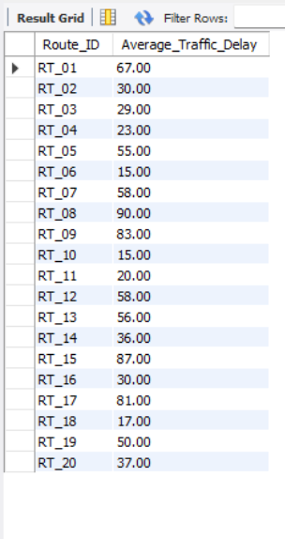
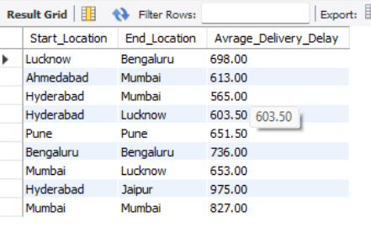
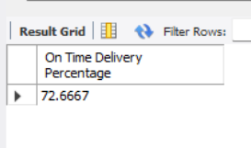
Average Delivery Delay per Region (Start_Location).
On-Time Delivery % = (Total On-Time Deliveries / Total Deliveries) * 100.
Average Traffic Delay per Route.

Slide 19
Average Delivery Delay per Region (Start_Location).
On-Time Delivery % = (Total On-Time Deliveries / Total Deliveries) * 100.
Average Traffic Delay per Route.
select Start_Location,End_Location,round(avg(Traffic_Delay_Min+Average_Travel_Time_Min),2) as 'Avrage_Delivery_Delay' from routes group by Start_Location,End_Location ;
SELECT (SUM(CASE WHEN Actual_Delivery_Date <= Expected_Delivery_Date THEN 1 ELSE 0 END) / COUNT(Order_ID)) * 100 AS 'On Time Delivery Percentage'FROM orders;
select Route_ID,round(avg(Traffic_Delay_Min),2) as 'Average_Traffic_Delay' from routes group by Route_ID;

Slide 20
THANK YOU

Slide 21
VIDEOS LINKS
VIDEO 1
https://www.loom.com/share/3557192399f6430a97995605c3812428
VIDEO 2
https://www.loom.com/share/0a3990914a1e4922ada6b637bbd8c325
VIDEO 3
https://www.loom.com/share/eed1f61284e64ac9b20c965d333d2c05

